Slide 1
Virtual Server Monitoring and Performance Optimization
S Manikandaa
Data Engineer
13/03/2026

Slide 2

Problem Statement
Example:
XYZ Corporation operates a distributed cloud infrastructure with multiple virtual servers hosting critical applications. Monitoring server performance and identifying resource bottlenecks is challenging without an efficient data pipeline. This project builds an end-to-end pipeline to ingest, process, and visualize server performance data.

Slide 3

Architecture
CSV Server Logs ↓ Python Data Ingestion (Pandas) ↓ Data Cleaning & Transformation ↓ Feature Engineering ↓ Processed Dataset ↓ Power BI Dashboard

Slide 4

Data Processing
What I have done in the dataset:
Removed invalid resource utilization values
Handled duplicate server logs
Converted timestamps to datetime format
Derived additional monitoring metrics
New metrics created:
Total Network Traffic Average Network Traffic Server Availability CPU Status Classification

Slide 5
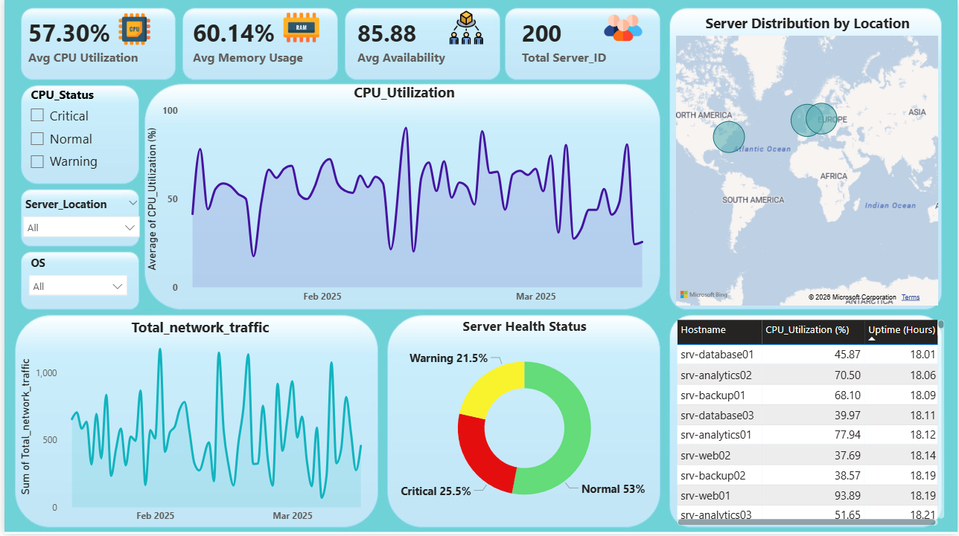

Slide 6
Power BI Dashboard
visuals:
CPU utilization trend
Memory usage analysis
Network traffic monitoring
Server availability statistics
Server health status distribution

Slide 7
Key Insights
Some servers show high CPU utilization
Network traffic patterns indicate peak usage periods
Server availability remains above X% for most servers

Slide 8

Challenges & Improvements
Challenges:
Handling timestamp format conversion
Derive meaningful monitoring metrics
Creating a simple understandable dashboard for clarity
Future Improvements:
Real-time streaming pipeline
Alert system for critical servers
Automated anomaly detection

Slide 9

Thank you

